Slide 1

Intro to Machine Learning
YOUR COURSE NAME | IRONHACK

Slide 2

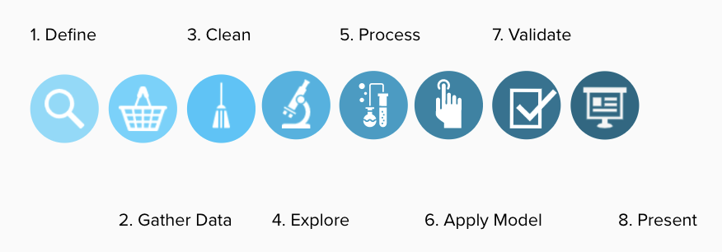
DATA ANALYTICS
DATA ANALYSIS PROCESS

Slide 3

IRONHACK BOOTCAMP
TYPES OF
DATA ANALYSIS
Descriptive
Diagnostic
Predictive
Prescriptive
Summarize existing data to get a picture of what has happened or is happening
Uncovering the root cause of events
Forecast possibilities in the future
Analyzing and recommending the best actions

Slide 4


IRONHACK BOOTCAMP
Machine Learning
Supervised Learning
Unsupervised Learning
Credit: Unsplash

Slide 5
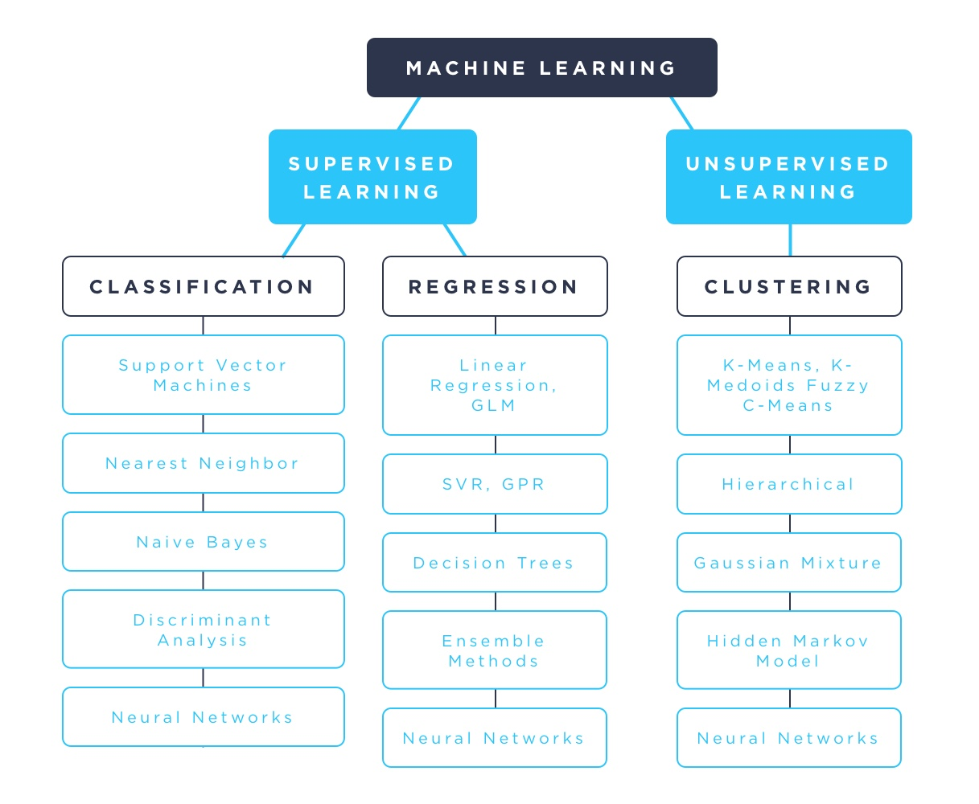
IRONHACK BOOTCAMP

Slide 6

Supervised Learning.

Slide 7
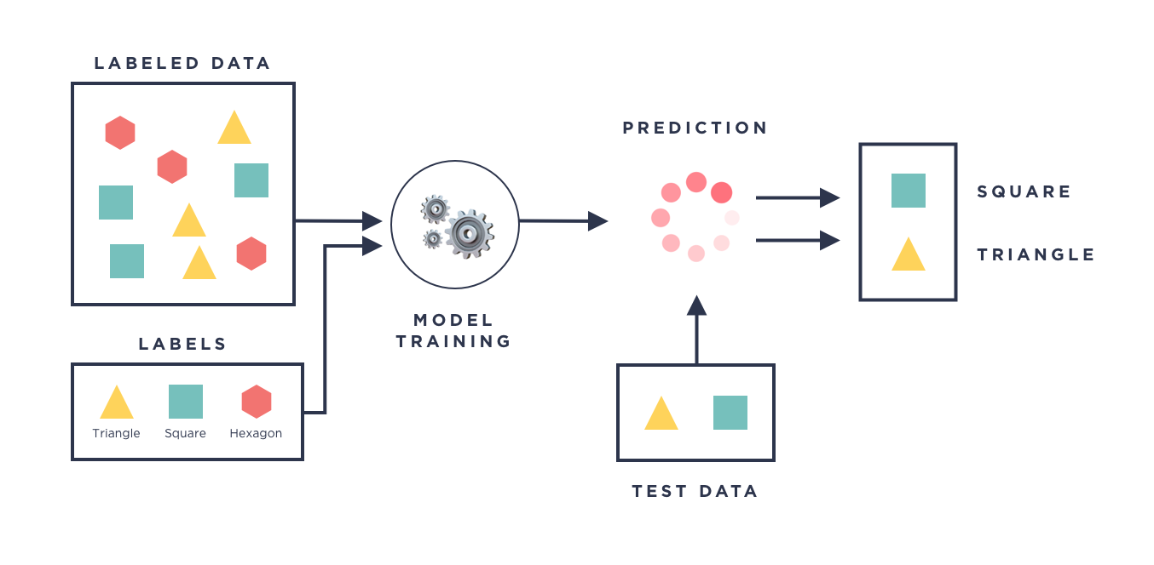
IRONHACK BOOTCAMP

Slide 8
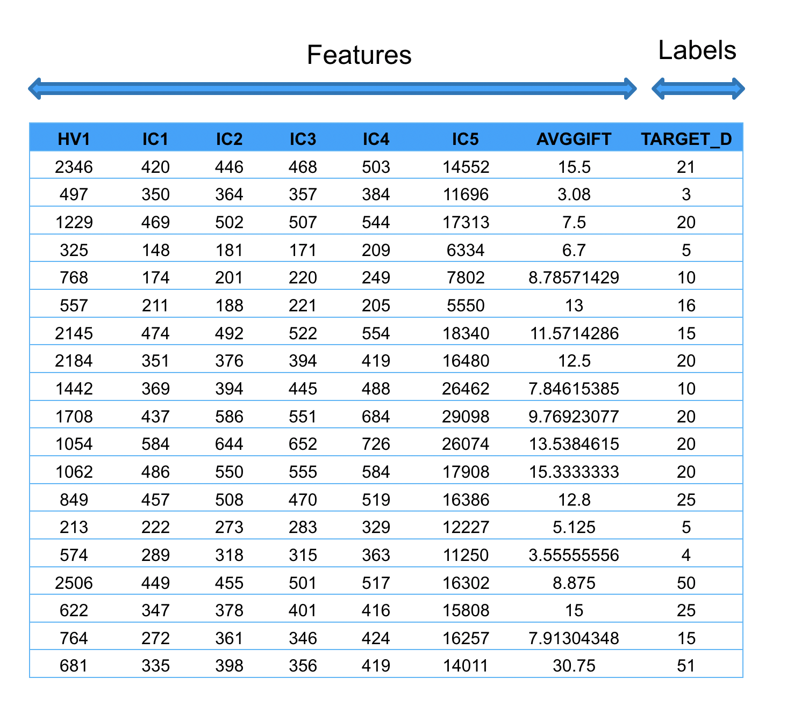
IRONHACK BOOTCAMP

Slide 9
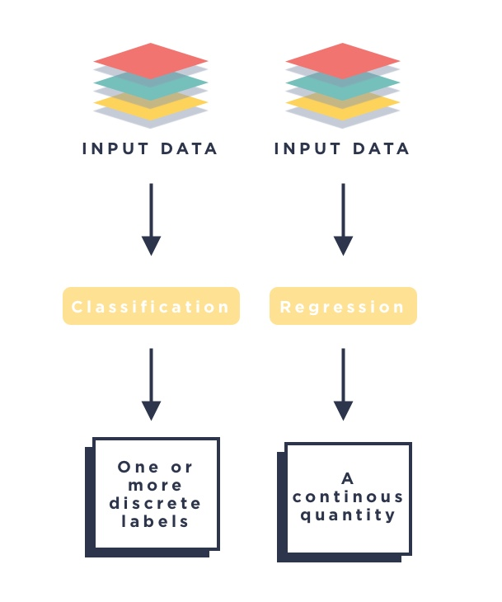
IRONHACK BOOTCAMP

Slide 10
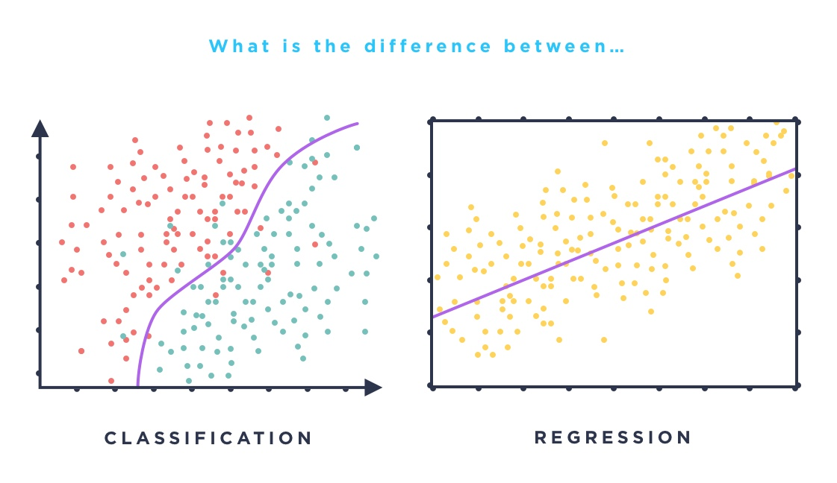
IRONHACK BOOTCAMP

Slide 11
Unsupervised Learning.

Slide 12
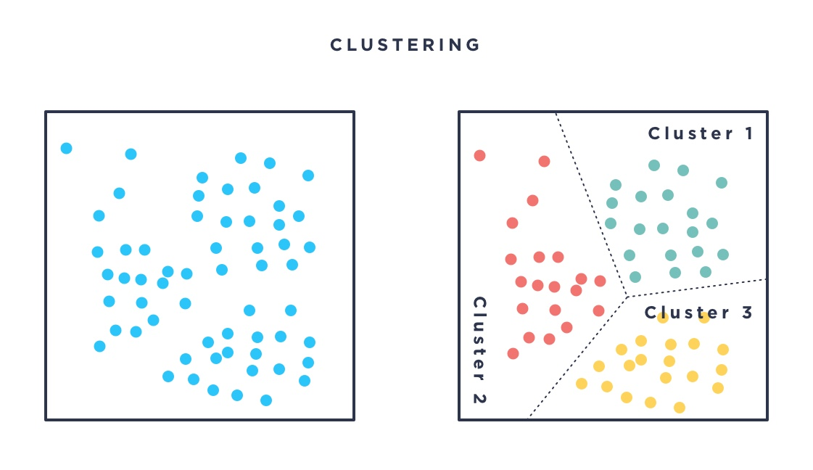
IRONHACK BOOTCAMP

Slide 13


